Slide 1

Computationally Modeling Reasoning
Professor John Licato
University of South Florida
First-Order Resolution and SLD Resolution

Slide 2
Converting FOL formulae to CNF
Convert to negation-normal form
Standardize variables
Prenex form and Skolemize
Drop universal quantifiers
Convert resulting ZOL* formula to CNF

Slide 3
1. Convert to negation-normal form
Remove conditionals
Bring negation symbols to the lowest level possible
Notes:
&\neg(p \wedge q) \text{ becomes } \neg p \vee \neg q\\
&\neg(p \vee q) \text{ becomes } \neg p \wedge \neg q\\
&\neg \forall_x \phi(x) \text{ becomes } \exists \neg \phi(x)\\
&\neg \exists_x \phi(x) \text{ becomes } \forall \neg \phi(x)

Slide 4
2. Standardize variables
Easiest way: give each quantifier a unique variable name
Even when they don’t conflict! This makes things easier later
Notes:
(\exists_x &\phi(x)) \vee (\forall_x \phi(x))\\
&\text{ becomes }\\
(\exists_{x_1} &\phi(x_1)) \vee (\forall_{x_2} \phi(x_2))

Slide 5
3. Prenex form and Skolemize
3a: Start by converting all formulae to prenex normal form---all quantifiers should be the top-level operators of the formula
Be careful to preserve quantifier order!
This is not in prenex form (why?):

Slide 6
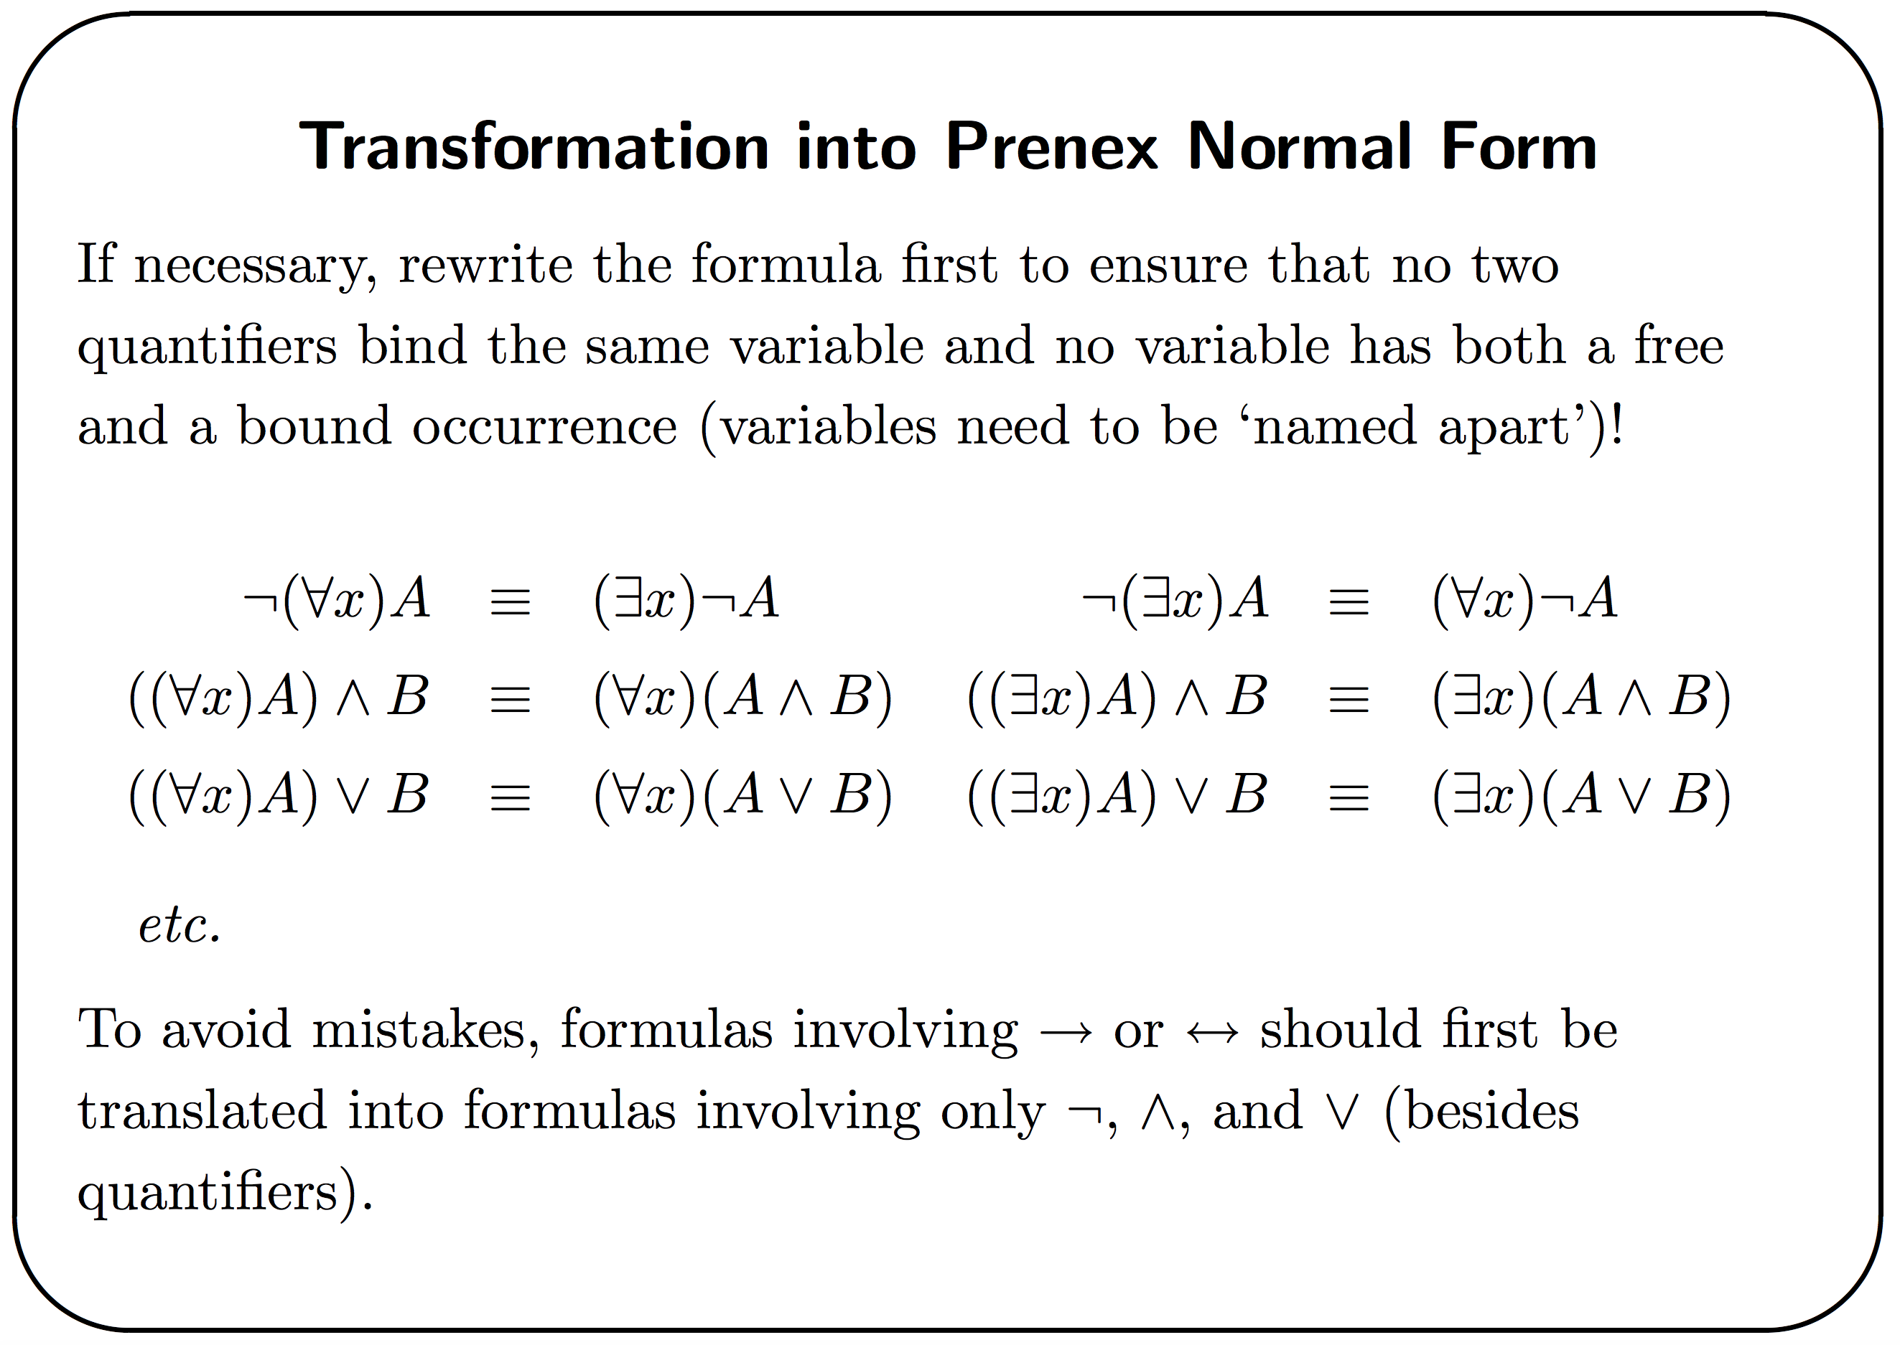
Source: https://staff.science.uva.nl/u.endriss/teaching/cs3aur-kings-2002/pdf/resolution.pdf

Slide 7
When you “extract” a quantifier, their quantified variable must not exist in the other term This is why the renaming step is important!
This formula:
Is NOT the same as:
But rather:
Notes:
(\forall_x P(x)) \wedge (\exists_x Q(x))\\
\\
\forall_x \exists_x (P(x) \wedge Q(x))\\
\forall_{x_1} \exists_{x_2} (P(x_1) \wedge Q(x_2))

Slide 8
3. Prenex form and Skolemize
3b. Replace all existential quantifiers with skolem functions, which replace quantified variables with a function depending on the previously quantified variables
Do this left-to-right
is replaced by
Notes:
\forall_{x_1} \forall_{x_2} ... \forall_{x_n} \exists_y \phi(x_1, ..., x_n, y)
\forall_{x_1} \forall_{x_2} ... \forall_{x_n} \phi(x_1, ..., x_n, f_y(x_1, ..., x_n))

Slide 9
What are skolem functions?
What factors does existentially quantified variable depend on?
Given a boy, f(boy) returns the girl who loves that boy
If there are no quantifiers to the left of the existential, then it doesn’t depend on anything:
Technically, f_{x} here is a 0-ary function. Here we treat it as a fixed constant object, since the function f_{x} only has one possible output

Slide 10
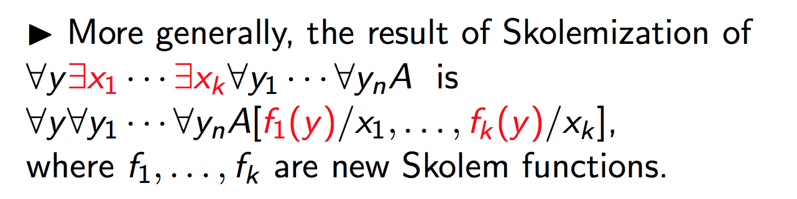
Source: https://pdfs.semanticscholar.org/presentation/8846/d8317d9e2eaa14e89dda0120929d86261d25.pdf
Turns into…?
Note: Skolemization preserves satisfiability, not equivalence!

Slide 11
4. Drop universal quantifiers
Now that all we have are universal quantifiers, get rid of them
But never forget which are variables and which are constant objects!
One standard way is to use different types of symbols (capitals vs. lowercase; a,b,c,… vs …x,y,z; etc.)
But this won’t suffice for your assignment!
Notes:
\forall_{X_1} \forall_{X_2} P(X_1, X_2, a) \text{ == } P(X_1, X_2, a)

Slide 12
Now, formula should have no quantifiers
How do you handle this in your assignment?
Somehow, you need to keep track of which symbols are variables, and which are constants / functions
You can’t assume that variables are capitalized, or that they are at the end of the alphabet, etc., and vice versa
Your program will be provided with S-notation formulae; in which every symbol is of unambiguous type
Every time you remove a universal quantifier, record the quantified variable in a “variable table”

Slide 13
Recall: Every PC formula can be converted to CNF!
Procedure C(F):
Replace all φ₁→φ₂ with ¬φ₁∨φ₂
Distribute all negations as far as you can
Remove unnecessary parentheses, e.g. φ₁∧(φ₂∧φ₃) to φ₁∧φ₂∧φ₃
If F is now CNF, then return it
If F is now φ₁∧φ₂∧…∧φ_{n}:
Return C(φ₁)∧C(φ₂)∧…∧C(φ_{n})
If F is now (φ₁¹∧…∧φ_{n1}¹)∨(φ₁²∧…∧φ_{n2}²)∨…∨(φ₁^{m}∧…∧φ_{nm}^{m}):
Return the CNF formula where each clause contains exactly one literal from each of the clauses in F:
This procedure will always return a CNF formula

Slide 14
Practice: carry out steps 1-4
Notes:
&\text{1)} \forall_x \exists_y (\forall_z P(x,y,z)) \rightarrow Q(x)\\
&&\neg P(x, f_y(x), f_z(x)) \vee Q(x)\\
&\text{2)} \forall_y ((\forall_x \forall_y P(x,y)) \rightarrow \exists_x R(x,y))&\\
&&\neg P(f_x(y), f_x(y)) \vee R(f_u(y), y)\\
&\text{3)} \neg \exists_x \forall_y (P(x) \rightarrow \exists_z (\forall_u Q(y,z) \rightarrow R(u,z)))\\
&&P(x) \wedge Q(f_y(x), z) \wedge \neg R(f_u(x, z), z)

Slide 15
You should start on the project now.
At the very least, decide on your teams today.
See the last slide in this unit for a suggested timeline
If you wait until the last week or two, you will in all likelihood fail. There are way too many parts that must be created and tested.
Do NOT treat the next few weeks as if this class is giving you a break with no homework, tests, etc. You should be working on this every week from now until it is due.

Slide 16
Refutation Proving with FOL resolution
Negate the formula to prove first!
Then, convert all formulae to CNF
Split up every clause
Perform resolution using FO unification
If we end up with an empty clause, the original theorem is true.
If we are unable to end up with an empty clause, then we have found a counterexample, and the original theorem is false.

Slide 17
Example 1:

Slide 18
Example 2:

Slide 19
Example 3:

Slide 20
Example 4:
Notes:
&\neg \exists_x \forall_y (P(x) \rightarrow \exists_z (\forall_u Q(y,z) \rightarrow R(u,z)))\\
&\text{Prove:}\\
&\forall_x \neg R(x, a)

Slide 21
Why don’t we combine all possible pairs?
Recall that in propositional calculus, when we resolved over proposition p, we had to combine all pairs of clauses where one had p and the other –p. Why don’t we do this with first-order resolution?
Answer: In the propositional case, we are trying to derive an entire formula that is equisatisfiable to our original.
We *could* do that with FOL as well, but it typically would produce huge formulas (remember that FOL has potentially infinite numbers of objects). So instead, we’re doing a restricted version that focuses on trying to derive empty clauses.
The trade-off is that we might end up at dead-ends, and have to back up. For example:
x/a
x/b
Now what?
Back up, dead end!
Notes:
\{P(x), \neg Q(x)\} \; \; \; \; \{Q(a)\} \; \; \; \; \{\neg P(a)\} \; \; \; \; \{Q(b)\}

Slide 22
Answering questions w/resolution
What if we want resolution to answer a question for us?
We can define a predicate ans(x)
We ask the resolution prover to prove:
Where phi defines the conditions the answer must satisfy
This is equivalent (after negation) to the following CNF:

Slide 23
Example: Question answering
“Who is older than son?”
<< added in this clause, already negated
If done correctly, and an answer can be found with the above information, this will yield the answer ans(a) where a is the object that satisfies the query.
Notes:
&Mother(mom,son)\\
&Alive(mom)\\
&\forall_x \forall_y Mother(x,y) \rightarrow Parent(x,y)\\
&\forall_x \forall_y (Parent(x,y) \wedge Alive(x)) \rightarrow Older(x,y)\\
&ans(x) \vee \neg Older(x,son)

Slide 24
FO Resolution will not always terminate
But does that mean it’s fully complete?
No! FO resolution is only refutation-complete: If the premises lead to a contradiction, resolution will prove it. It also means that given premises and a formula that follows from it, we can show it follows.
This means that it’s possible there is a formula s.t. FO resolution will never find a proof of p, and will also never find a proof of –p. But if a proof of p or exists in FOL, then FO resolution, through refutation proving, will find it (eventually).
FO resolution is sound: If it proves a conclusion follows from premises, it actually does follow from premises
FO resolution is consistent: Given some premises, resolution will never prove p and also prove ¬p

Slide 25
Resolution will not always terminate
But if we want to show that a formula does not follow from the premises, we run into problems
We can always find a P,f where FO resolution will either not terminate on P⊢f, or not terminate on P⊢¬f.
If resolution doesn’t terminate on P ⊢ f, it does NOT mean P ⊢ ¬f (and vice versa)!
This is particularly the case when the domain of objects is possibly infinite, i.e. the “successor” function in arithmetic (e.g., SUCC(0)=1, SUCC(1)=2, etc.)
Gödel’s incompleteness theorems guarantees that no FO proof system for arithmetic (satisfying certain minimal properties) will ever be complete
Even if you add code to check for some of these loops, there still will exist some premises/formulae that will cause this behavior
But let’s blame this on FOL, not resolution!
Therefore, we must always assume that FO resolution might get stuck in a loop --- that’s why most provers have timeouts

Slide 26
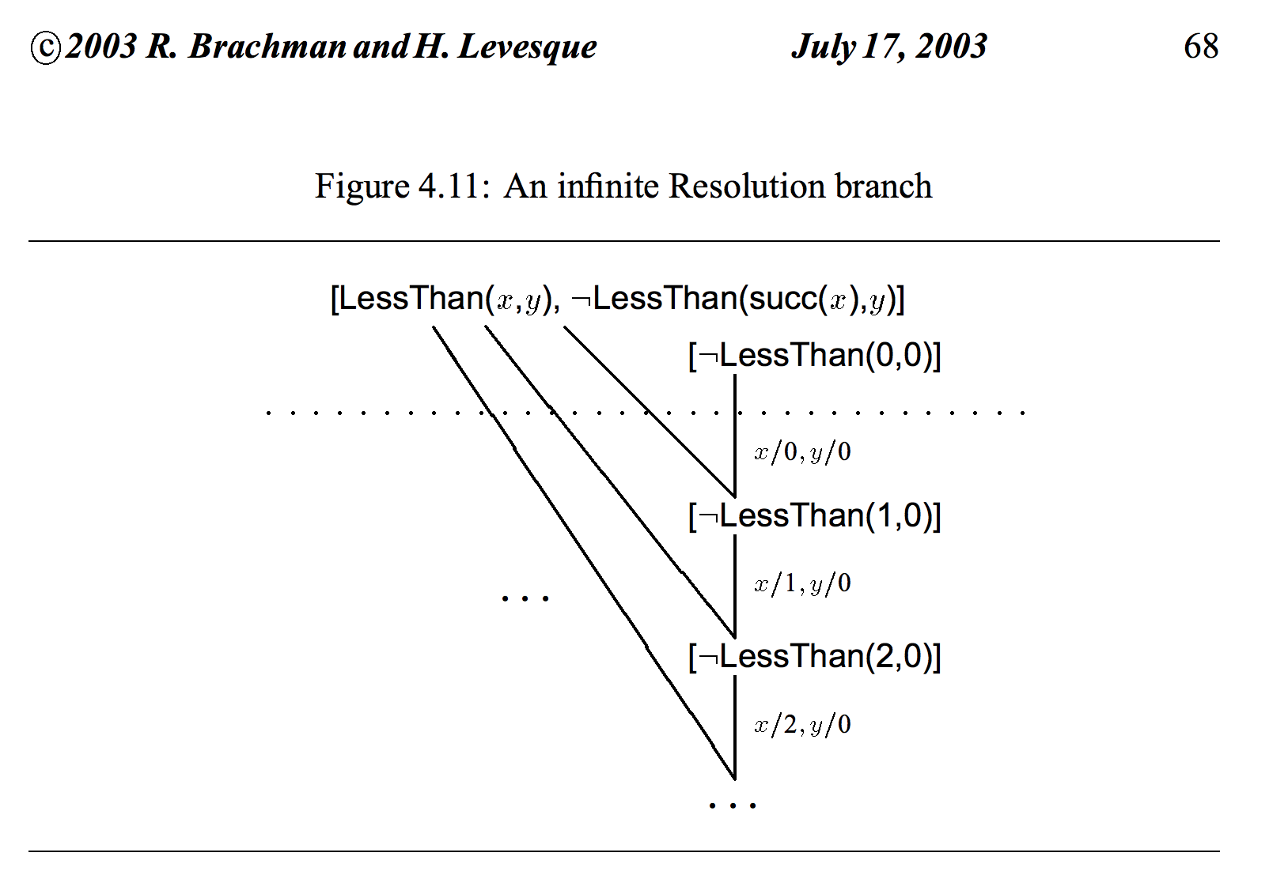
Source: Brachman and Levesque, http://citeseerx.ist.psu.edu/viewdoc/download?doi=10.1.1.301.439&rep=rep1&type=pdf

Slide 27
Horn Clauses
In some special cases, we can perform a faster version of resolution
Horn clauses can be alternately defined as:
Disjunctions with exactly one positive literal
Conjunctions of disjunctions, each with exactly one positive literal
Disjunctions of the form:
PROLOG is built on horn clauses
Sometimes they’re written with the conjunction on the right side

Slide 28
Horn clauses can be thought of as directed graphs with some of the nodes as “gates”
Each gate is only passed if all nodes pointing to it are proven
a∧b→c
b∧d→c
a→d
b
GOAL: c
c
a
b
d

Slide 29
Backward chaining
a∧b→c
b∧d→c
a→d
b
a
GOAL: c
(PROLOG goes depth-first, left-to-right)
c
a
b
d

Slide 30
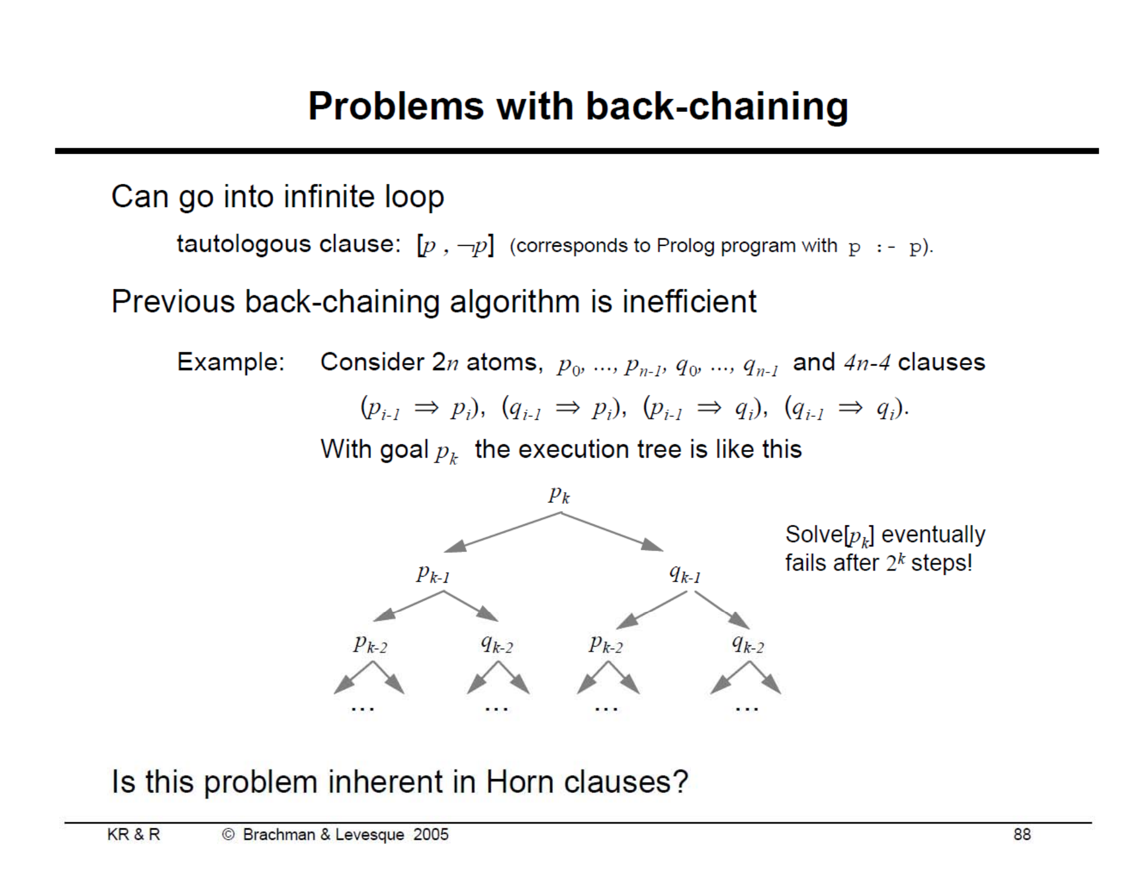
Source: https://web.stanford.edu/class/cs227/Lectures/lec08a.pdf

Slide 31
Forward chaining
a∧b→c
b∧d→c
a→d
b
a
GOAL: c
c
a
b
d

Slide 32
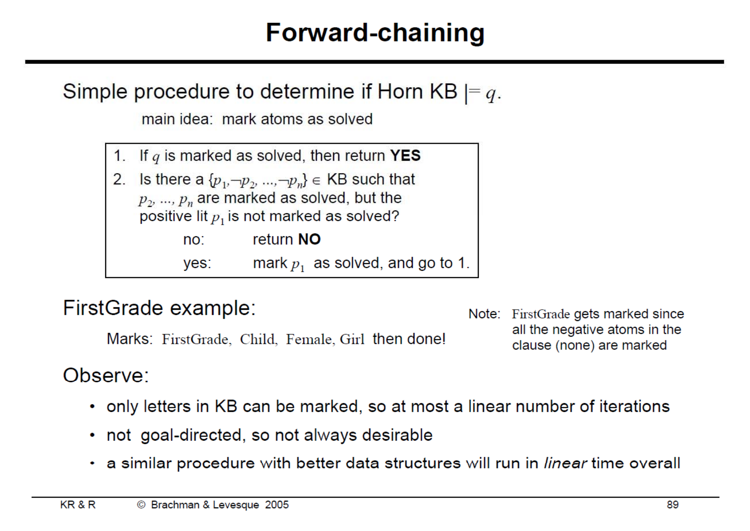
Source: https://web.stanford.edu/class/cs227/Lectures/lec08a.pdf

Slide 33
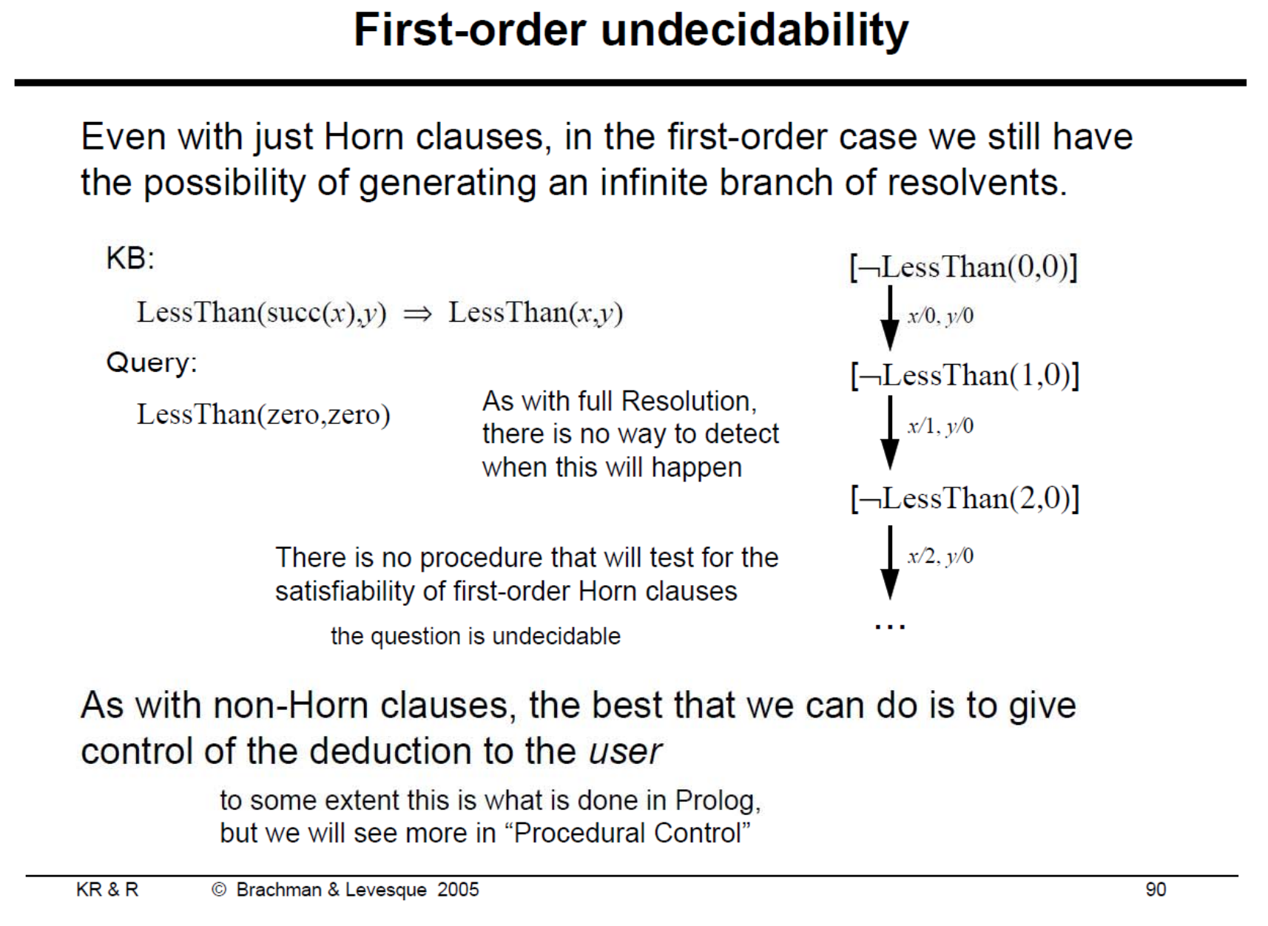
Source: https://web.stanford.edu/class/cs227/Lectures/lec08a.pdf

Slide 34
Additional Sources
https://en.wikipedia.org/wiki/Conjunctive_normal_form#First-order_logic
https://courses.cs.washington.edu/courses/cse473/01sp/slides/fol-inference-4.pdf
http://www.cs.toronto.edu/~sheila/384/w11/Lectures/csc384w11-KR-tutorial.pdf
http://citeseerx.ist.psu.edu/viewdoc/download?doi=10.1.1.301.439&rep=rep1&type=pdf
https://en.wikipedia.org/wiki/SLD_resolution

Slide 35
The “find inconsistent sets” task
A “formula set” is a set of formulae, which together may or may not lead to a contradiction (is inconsistent)
You are given a set of formula sets, and must determine which of them are inconsistent
You have an overall time limit. In this time limit, you must identify as many inconsistent formula sets as possible.
If you identify a formula set as inconsistent and it’s actually not inconsistent, you lose points
If you fail to identify a formula set as inconsistent and it actually is, you lose points
There is an enormous amount of variability here:
How do you know which to run your theorem prover on first?
How long should you wait on a given formula set before abandoning and trying another?

Slide 36
Project 2: Due 11/1 (Presentations 10/30)
You will write a refutation prover for FOL using first-order resolution (described in next lecture)
You will solve the “find inconsistent sets” task, but have some clever innovation(s) to make it better.
Must work in Python 3.4+ without any special libraries to be installed
Submit a file p2.py with no outputting code (print or any similar statements) at any level. This file should have a function findIncSet(fSets), where:
fSets: A list (the master list) containing lists (the formula sets) of strings.
Each string is an S-expression of a well-formed FOL formula.
All non-operator symbols will be lower-case alphanumberic strings
All formulae are well-formed; all non-quantified objects are actually objects (and vice versa)
Roughly 50 percent of the formula sets are inconsistent
The number of formula sets will be between 2 and 10,000,000.
Your code will return a list of integers:
These integers correspond to the indices of the formula sets that you believe are inconsistent.
Indices should be zero-indexed: the first formula set in the master list has the index ‘0’.
No whitespace, newline characters, etc. Just integers (not strings!) separated by commas.
Grading:
You start with 100 points (see rubric on next slide; this component is approximately 65% of the grade for this project)
It is crucial that you work together intelligently on this. Perhaps one person can write the convertor to CNF, one can write the unification algorithm, one can do rigorous testing of all modules, one can design the selection heuristic, etc. There is a lot of work to do for this project --- avoid working alone!

Slide 37
Project 2: Due 11/1
Groups of up to 4
Your group will also give a 10-minute presentation explaining your algorithm’s uniqueness---do not waste time explaining basics!
At the end of the day, there will be a competition for the fastest FOL prover; winner will get bonus points
My code will import your “p2.py” once, and call the function findIncSet() multiple times
If it fails on any instance (exception or wrong answer), it’s disqualified
The fastest overall time wins
RUBRIC:
75% - Code quality
65% - Code is a variant of FO-resolution, satisfies all requirements in previous slide, runs correctly
This component is calculated by starting with 100 points:
Let n be the number of formula sets in the input
If you output the index of a formula set that is not inconsistent, then you lose 100/n points.
If you fail to output the index of a formula set that is inconsistent, then you lose 100/n points.
If you output an invalid index, a string in an invalid format, or generate an exception, then you lose 100 points. TEST YOUR CODE!
10% - Your variant of FO-resolution must be clever; creative; non-trivial (or if you take this idea from somewhere, properly cite it)
25% - Presentation
5% - Time limit (not too short or long)
5% - Workload appeared shared
15% - Presentation was clear, algorithm easy to understand (peer reviewed)
10% - Bonus for winning competition

Slide 38
Project 2: Recommended Timeline
10/12 – Unification algorithm complete
10/19 – FOL-to-CNF algorithm complete, Resolution algorithm complete
10/26 – Novel heuristic and presentation complete, testing complete
10/31 – 11/1 – Presentations
11/1 – Submit code

